Slide 1
Human Trafficking and Child Welfare in NC
D. F. Duncan
Research Professor
UNC-CH School Of Social Work
Eastern Region Program Administrators
August 23, 2018

Slide 2
Agenda
Introduction to Project NO REST
Human Trafficking in North Carolina
Human Trafficking and Child Welfare
Identifying Potential Human Trafficking Survivors
Group Discussion
Notes:
Dean

Slide 3
Language & Sensitivity
What ideas, images, or words come to mind when you hear the words “Human Trafficking”?
Notes:
Start with question.
Note responses on flip chart.
This is an opportunity to get a read from the group regarding their knowledge of trafficking?
Let’s see if any of these change after our presentation.

Slide 4
Project NO REST
Project NO REST (North Carolina Organizing and Responding to the Exploitation and Sexual Trafficking of Children) is a five year effort funded by the U. S. Children’s Bureau
The project addresses the trafficking of youth in North Carolina through age 25
A primary focus is the trafficking of child-welfare involved youth
Notes:
Dean

Slide 5
Project NO REST Goals
Increase awareness of human trafficking affecting children and youth in NC, especially those involved in the child welfare system
Reduce the number of these youth who are trafficked
Improve outcomes for those who are trafficked
Notes:
Dean

Slide 6
Project NO REST Goals
Overall, strengthen and expand the anti-trafficking infrastructure in North Carolina
Increase the capacity of agencies statewide to identify human trafficking and to offer victims services
Notes:
Dean

Slide 7
Project NO REST
Project NO REST is a federally funded project to address trafficking of child welfare-involved youth in North Carolina
The project brought together a broad base of stakeholders from public agencies and private organizations to develop and implement a comprehensive strategic plan to address trafficking of these youth
That plan addresses approaches to prevention as well as ways to engage youth, screen them, and provide services so that they can heal and transition to independent living
Notes:
Dean

Slide 8
Project NO REST
You can find that plan at:
http://projectnorest.web.unc.edu/

Slide 9
Project NO REST
We also recruited five pilot sites, representing 17 counties and the Eastern Band of the Cherokee Indians, to implement that plan

Slide 10
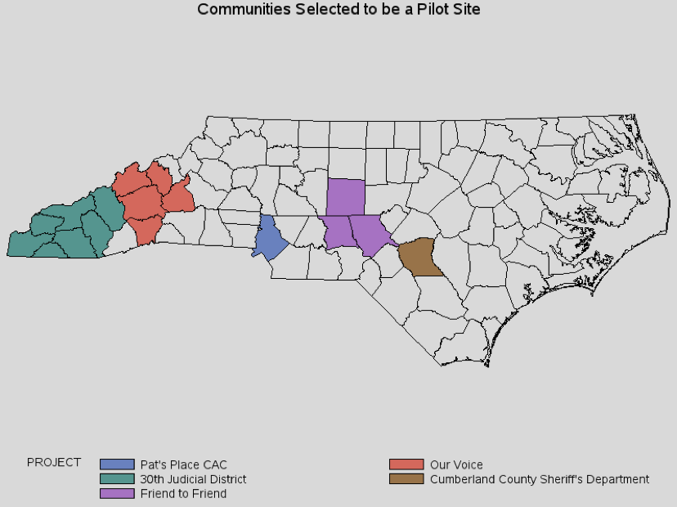
Project NO REST Pilot Sites

Slide 11
Human Trafficking in North Carolina

Slide 12
Human Trafficking in North Carolina
Common Threads
https://www.youtube.com/watch?v=nD21t2kzkts
Notes:
Dean

Slide 13
Human Trafficking in North Carolina
What is human trafficking?
  Human trafficking is defined as forcing, fooling or frightening someone into performing labor or sex acts for profit. Any commercial sex act with minors is considered trafficking.
  Human trafficking can occur anywhere, in large cities, small towns and rural areas.
Notes:
Nancy

Slide 14
Human Trafficking in North Carolina
There is human trafficking in North Carolina.
We think the state is a hub for human trafficking due to its major highways, big sporting events, and large population.
Trafficking occurs all over the state.
Notes:
Nancy

Slide 15
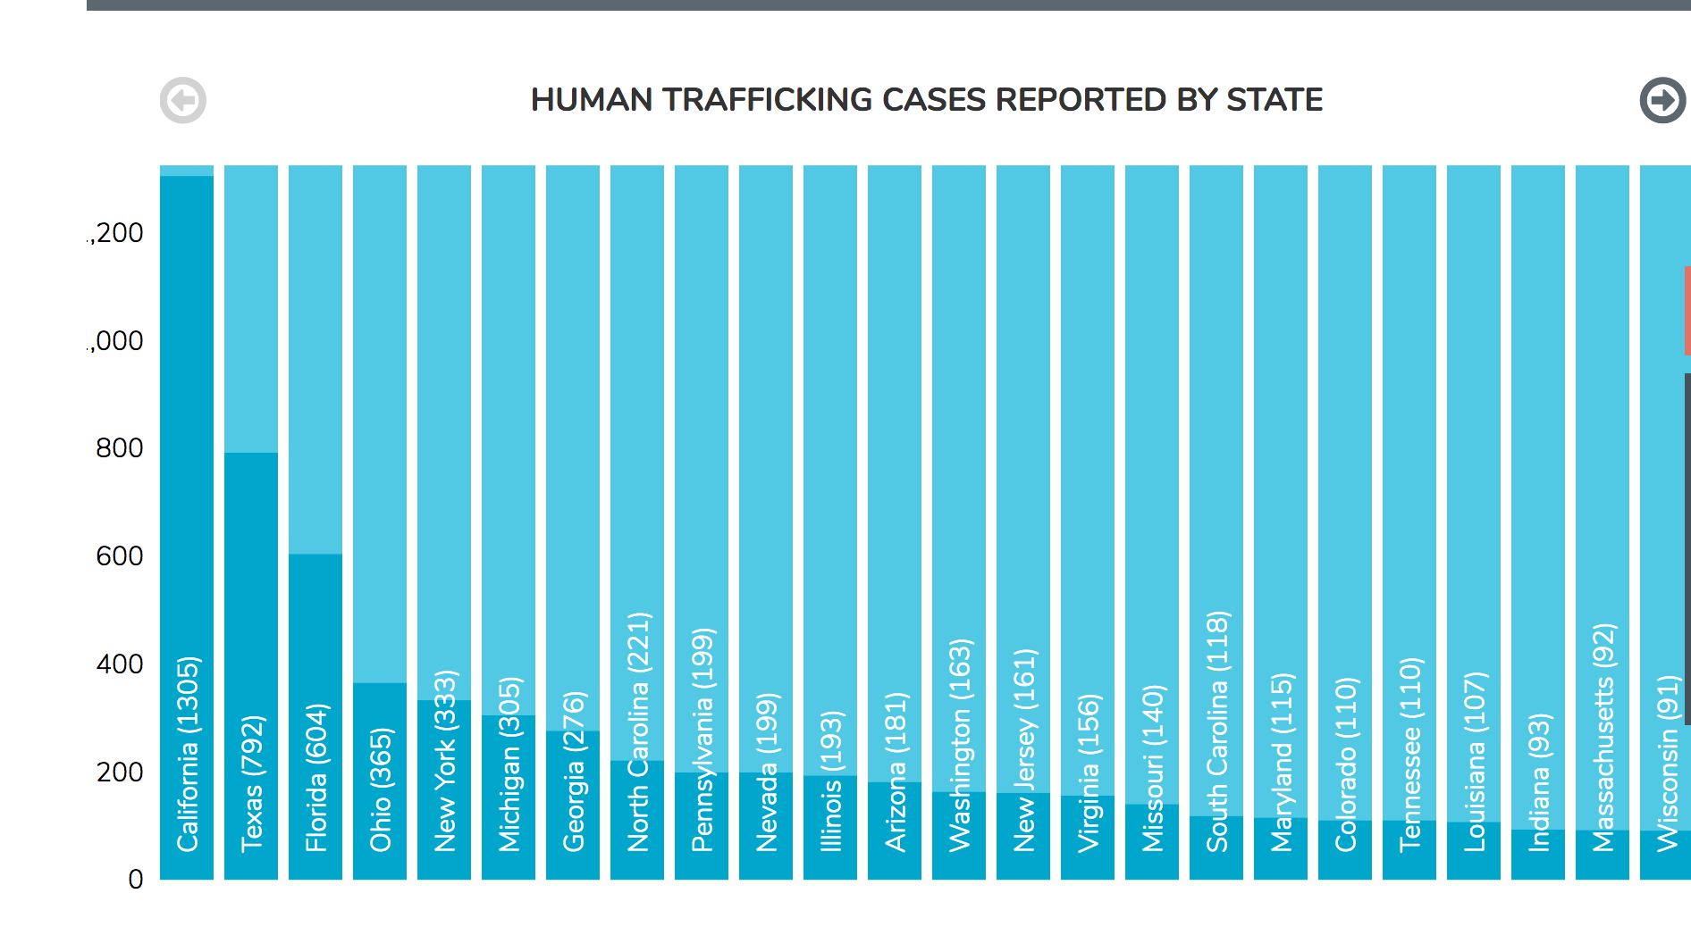
Human Trafficking in North Carolina
In 2017, North Carolina ranked 8th in the nation for the number of human trafficking cases
Notes:
Nancy

Slide 16
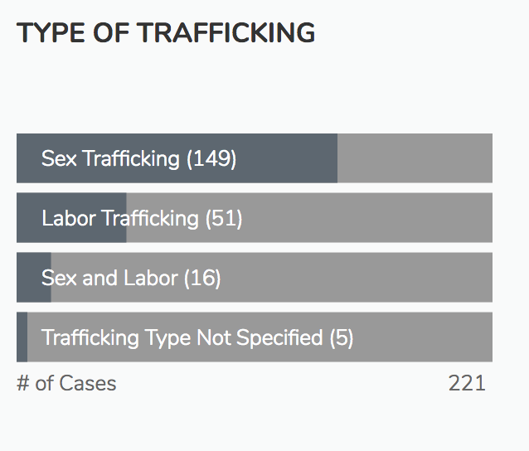
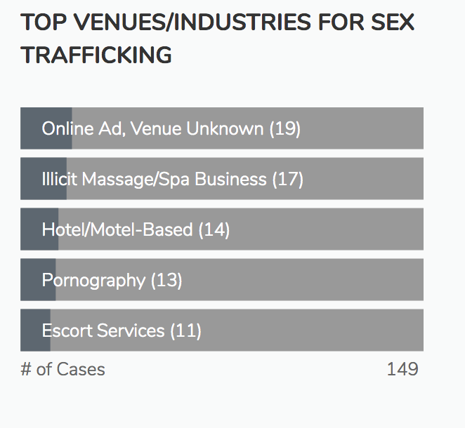
Human Trafficking in North Carolina

Slide 17
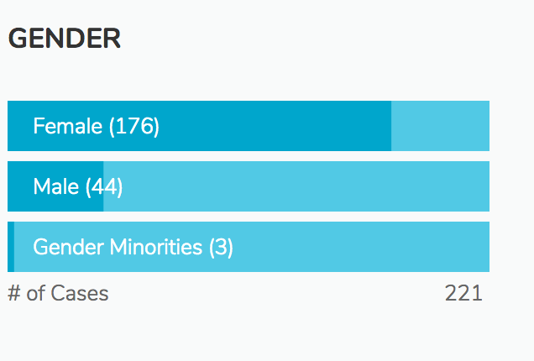
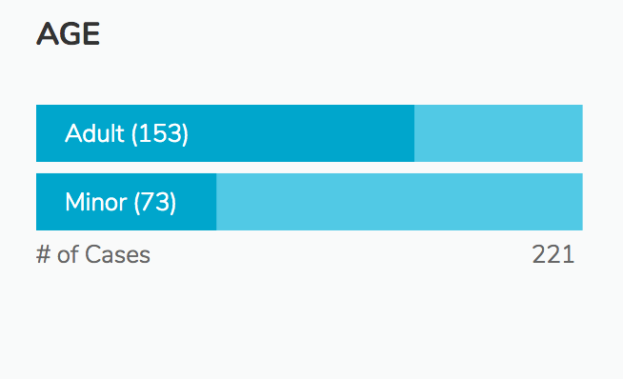
Human Trafficking in North Carolina
Notes:
Nancy

Slide 18
Human Trafficking in the US: Major Types
Escort Services
Illicit Massage, Health & Beauty
Outdoor Solicitation
Residential
Domestic Work
Bars, Strip Club, & Cantinas
Pornography
Traveling Sales Crews
Restaurants & Food Service
Peddling & Begging
Agriculture & Animal Husbandry
Personal Sexual Servitude
Health & Beauty Services
Construction
Hotels & Hospitality
Landscaping
Illicit Activities
Arts & Entertainment
Commercial Cleaning Services
Factories & Manufacturing
Remote Interactive Sexual Acts
Carnivals
Forestry & Logging
Health Care
Recreational Facilities
Source: https://polarisproject.org/sites/default/files/Polaris-Typology-of-Modern-Slavery.pdf
Notes:
Nancy

Slide 19
Human Trafficking in North Carolina
Human trafficking is one of the most difficult crimes to spot because victims are ordinary people. However, there are signs that can help you identify yourself and others as potential trafficking victims. Learning the risk factors and potential indicators is the first step in getting the help you or a victim needs.

Slide 20
Human Trafficking in North Carolina
Cindy
https://www.youtube.com/watch?time_continue=6&v=k90rPnuwNFY
Notes:
Nancy

Slide 21
What Are Risk Factors For Children Who Are Sex Trafficked?
Parental or Caregiver Risk Factors
  Abuse or Neglect
  Addiction (substances and gambling)
  Severe and (or) chronic psychological disturbances
  Teenage parenting
  Prolonged absence (prison, hospital) and (or) desertion
Source: Hargreaves-Cormany et al. 2016b
Notes:
Cindy introduces us to sex trafficking
Let’s look at Risk Factors for children who are sex trafficked.
Risk Factors are situations that may be present – Puts the child at risk. Does not mean there is trafficking but child is at “Risk”
We start with Parental - Caregivers

Slide 22
What Are Risk Factors For Children Who Are Sex Trafficked?
Child Factors
  Temperament
  Medical conditions
  Hospitalizations and (or) separations
  Genetic factors
Source: Hargreaves-Cormany et al. 2016b
Notes:
Here are child factors
Temperament – child’s personality, disposition, makeup

Slide 23
What Are Risk Factors For Children Who Are Sex Trafficked?
Environmental Factors
  Poverty
  Witnessing or being a victim of violence
  Lack of support and (or) resources
  Multiple out of home placements
  High stress and (or) chaos in the family or community
  Lack of stimulation
Source: Hargreaves-Cormany et al. 2016b
Notes:
Environmental Factors
These are situations you may see with the populations
Multiple out of home placements – Children in Foster Care

Slide 24
What Are Risk Factors For Children Who Are Sex Trafficked?
History of running away or getting kicked out of home
  Definition of running away or getting kicked out of home: Include times the youth did not voluntarily return within 24 hours, and include incidents not reported by or to law enforcement.
History of homelessness or housing instability

Slide 25
What Are Risk Factors for Foreign Nationals Who Are Trafficked?
May have specific vulnerabilities due to:
Low English proficiency
Cultural differences
Lack of trust of governmental authorities or systems
History of trauma, including civil unrest or prolonged community violence
Social isolation
Lack of legal status (documentation)
Notes:
Nancy

Slide 26
What Do We Know About Exploiters Who Traffic?
Four methods of sex trafficking
  Pimp Controlled
  Gang Controlled
  Familial
  Survival Sex
Mapp, 2016
Notes:
Dean

Slide 27
What Do We Know About Exploiters Who Traffic?
Motivation for most pedophiles is driven by sexual fantasy while the motivation for exploiters is frequently predatory in nature with the intent to gain financially or sexual gratification
Exploiters provide a false sense of love and often create an illusion of a fantasy life while preying on the victim’s vulnerabilities and attachment issues
They manipulate a victim to train and control them
This increases the victim’s physical and psychological isolation
Source: Hargreaves-Cormany et al. 2016a
Notes:
Dean

Slide 28
What Do We Know About Exploiters
When targeting victims, sex traffickers gain trust and confidence of vulnerable children or adults by manipulating their emotions and offering them a better life through false promises of security, protection and love
Victims typically form trauma bonds with their traffickers through traumatic dependency, shame, and hopelessness
Notes:
Dean

Slide 29
Human Trafficking and Child Welfare

Slide 30
Human Trafficking and Child Welfare
PL 113-183
Preventing Sex Trafficking and Strengthening Families Act
  Enacted September 29, 2014
Required state child welfare agencies to develop and implement policies, protocols, and procedures for:
  Identifying, documenting, and providing services for trafficking victims
  Reporting and locating children missing from foster care
  Collecting and reporting data
Notes:
Dean

Slide 31
Human Trafficking and Child Welfare
PL 114-22
Justice for Victims of Trafficking Act
  Enacted May 29, 2015
Requires state child welfare agencies to develop and implement policies and procedures for:
  Identifying and assessing reports involving known or suspected child trafficking victims
  Training child welfare workers
  Collecting and reporting data
Notes:
Dean

Slide 32
Human Trafficking and Child Welfare
House Bill 776
  Changes the definition of Abused Juveniles under GS 7B-101(1)
  Changes the definition of Neglected Juvenile under GS 7B-101(15)
Senate Bill 162
  Provision that allows human trafficking victims to use their status as a victim for certain protections and legal defenses
  Changes the definition of Abused Juveniles under GS 7B-101(1)

Slide 33
Human Trafficking and Child Welfare
You will need to screen to determine if the child is being held in involuntary servitude
Involuntary servitude is a type of human trafficking called labor trafficking. It is defined as:
  The performance of labor, whether or not for compensation, or whether or not for the satisfaction of a debt and
  By deception, coercion, or intimidation using violence or the threat of violence or by any other means of coercion or intimidation.

Slide 34
Human Trafficking and Child Welfare
You will need to screen to determine if the child is being held in sexual servitude
Sexual servitude is a type of human trafficking called sex trafficking. It is defined as:
  Any sexual activity as defined in G.S. 14-190.13 for which anything of value is directly or indirectly given, promised to, or received by any person, which conduct is induced or obtained by coercion or deception or which conduct is induced or obtained from a person under the age of 18 years or
  Any sexual activity as defined in G.S. 14-190.13 that is performed or provided by any person, which conduct is induced or obtained by coercion or deception or which conduct is induced or obtained from a person under the age of 18 years

Slide 35
Human Trafficking and Child Welfare
Sex trafficking sometimes occurs when individuals exchange children for acts of sex. This exchange may involve:
  An individual being directly or indirectly given, promised, or receiving anything of value in exchange for the child or
  An individual using a child or child’s acts of sex to satisfy a debt
Sex trafficking may involve:
  Allowing, forcing or coercing the child to engage in prostitution or
  Allowing, forcing or coercing the child to engage in the production of child pornography

Slide 36
Human Trafficking and Child Welfare
If the allegations meet the statutory criteria for juvenile human trafficking, the referral shall be accepted, regardless of the relationship between the perpetrator and the juvenile
Such reports must be accepted as abuse and neglect
Dependency may be present but if the report is screened in due to the human trafficking allegations, it must be screened in as abuse and neglect.

Slide 37
Human Trafficking and Child Welfare
The requirements of a CPS Assessment are not altered when it involves allegations of human trafficking
Within 24 hours of accepting the report the County child welfare agency must:
  Check the National Center for Missing and Exploited Children to see if the child or youth has been reported missing
  Check the North Carolina Center for Missing Persons to see if the child or youth has been reported missing
  Check with the appropriate local law enforcement agency to see if the child or youth has been reported missing/runaway

Slide 38
Human Trafficking and Child Welfare
If the child is a foreign national, you must notify the U.S. Department of Health and Human Services to facilitate the provision of interim assistance
The County Child welfare worker must contact OTIP Child Protection Specialists at childtrafficking@acf.hhs.gov or (202) 205-4582
You will need to provide the child’s name, age, location, country of origin, and plus some additional information

Slide 39
Identifying Potential Human
Trafficking Survivors

Slide 40
Identifying Potential Human Trafficking Survivors
Interviewers should be comfortable working with trafficking victims, sensitive to their special needs, and aware that they are likely to be suffering the impacts of traumatic experiences
It is critical to establish a safe place
Individual needs to feel comfortable and protected
Never interview within sight of the potential trafficker. Ensure privacy
The interviewer may experience secondary trauma
Notes:
We have talked about Risk Factors and Exploiters.
Think about the settings you work in or work with. How will you know if an individual is a survivor of human trafficking?
We refer to these individuals as survivors not victims even if they are currently being trafficked.
Know your level of comfort. Can’t address this issue if you are uncomfortable.
Look back at the flip chart. Can you talk to a 14 year old about being sex trafficked when you see them as prostitutes or promiscuous?
Give attention to the adult that is accompanying the youth. What observations do you have about their interactions with each other?

Slide 41
Identifying Potential Human Trafficking Survivors
Visible signs of abuse such as unexplained bruises, black eyes, cuts, or marks.
Fear of person accompanying them.
Exhibit hyper-vigilance or paranoid behavior.
Secrecy of whereabouts
Wearing new clothes of any style or getting hair or nails done with no financial means to do this independently.
Notes:
Does the child present at school with unexplained injuries?
Are there concerns with heir behavior? It is out of the norm for what you would expect?
A child with flashy new clothes

Slide 42
Identifying Potential Human Trafficking Survivors
A young person with a tattoo which he or she is reluctant to explain
Child’s appearance and/or actions contradict the information they give
Personal information such as age, name, and/or date of birth might change with each telling of the story or information given is contradictory
Has no identification or is not in control of his or her identification documents
Notes:
How old do you have to be before you can get a tattoo?
Child says she is 18 but language and behavior tell you different.
Person they are with will not allow them to hold identification documents even though they appear to be old enough and responsible.

Slide 43
Identifying Potential Human Trafficking Survivors
Frequency or multiple sexually transmitted diseases, STI or pregnancies
Unaccounted for times, vagueness concerning whereabouts, and/or defensiveness in response to questions or concerns
Truancy or tardiness from school
Notes:
Connect age, frequency
Children in school setting. Frequent absents. Very vague when asked why they were missing school.

Slide 44
Group Discussion
Case Scenario
What indicators of possible human trafficking are present in the scenario?
How would I respond if I were the legal custodian of Julie?
What resources would I contact for additional assistance?

Slide 45
Stay in Touch
Websites:
  http://projectnorest.web.unc.edu/
  https://www.projectnorest.org/
Social Media
  Project NO REST on Facebook
  Also a Spanish version on Facebook
  Project_NO_REST on Twitter
  project_norest on Snapchat

Slide 46
Question?
For more information, contact:
D. F. Duncan
dfduncan@email.unc.edu

